Slide 1
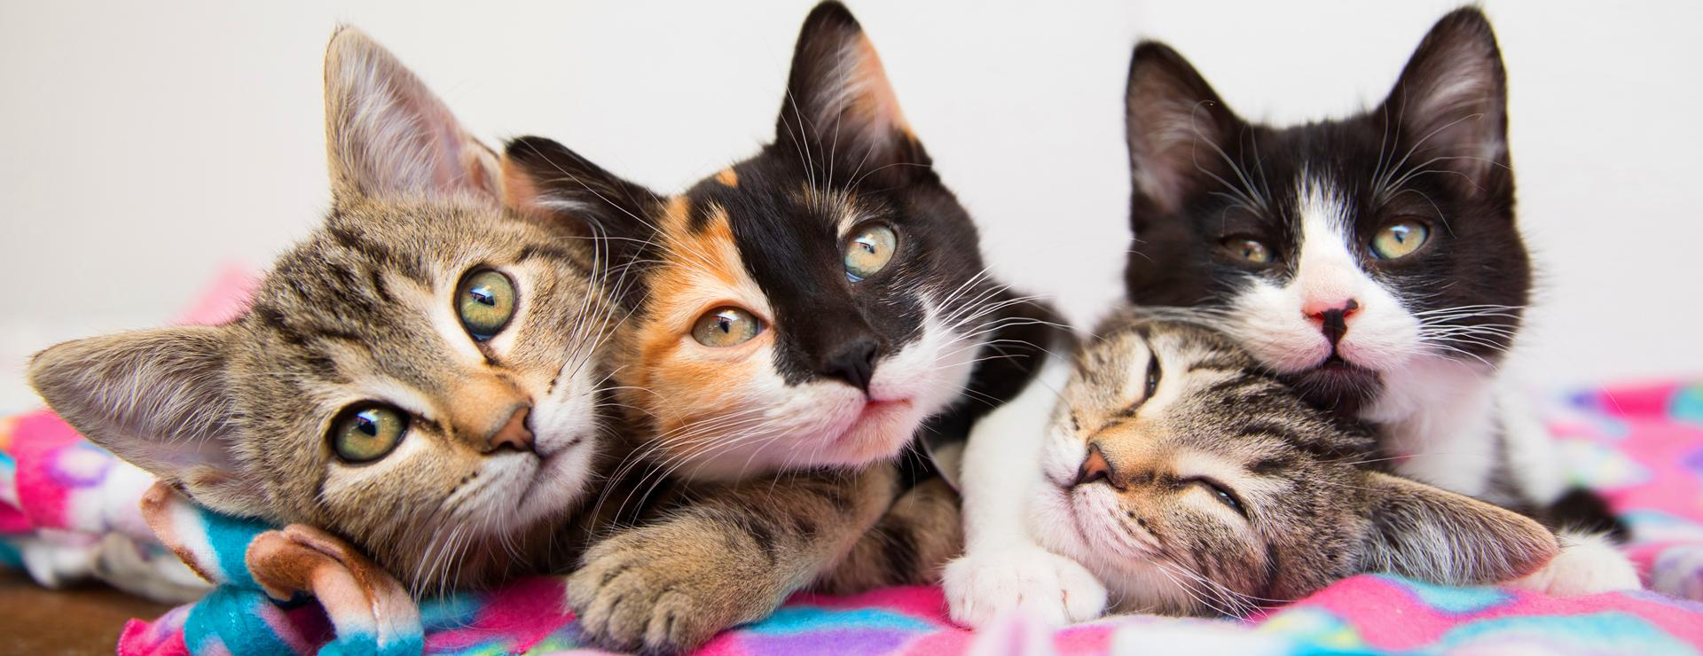
Private LLM + RAG
PyCon 2025
Yaacov Zamir <yzamir@redhat.com>

Slide 2

Running LLM on your hardware
Optimization
Custom knowledge domain
Agenda

Slide 3

Look ma’ no cloud

Slide 4
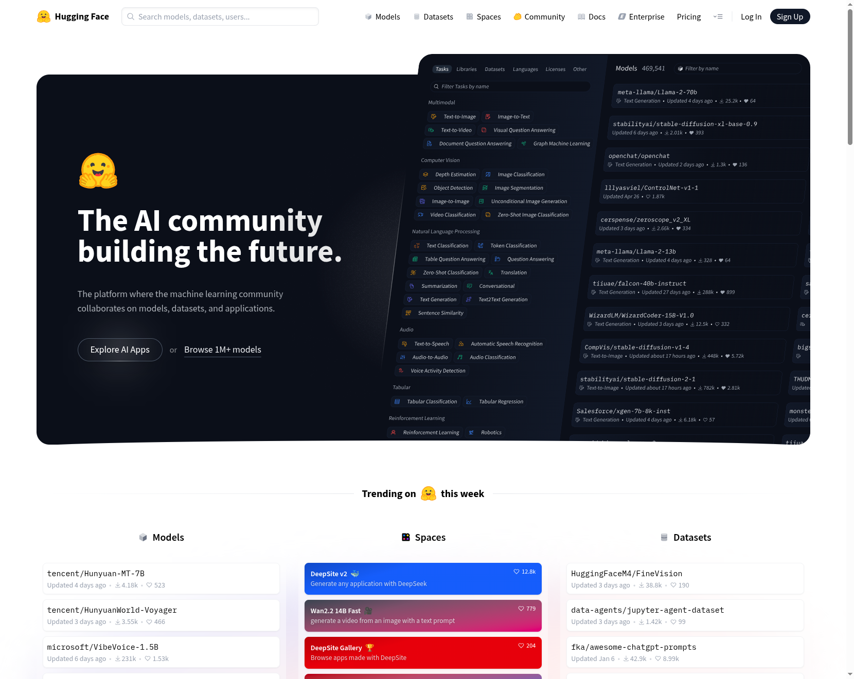
Choosing a model
https://huggingface.co/

Slide 5
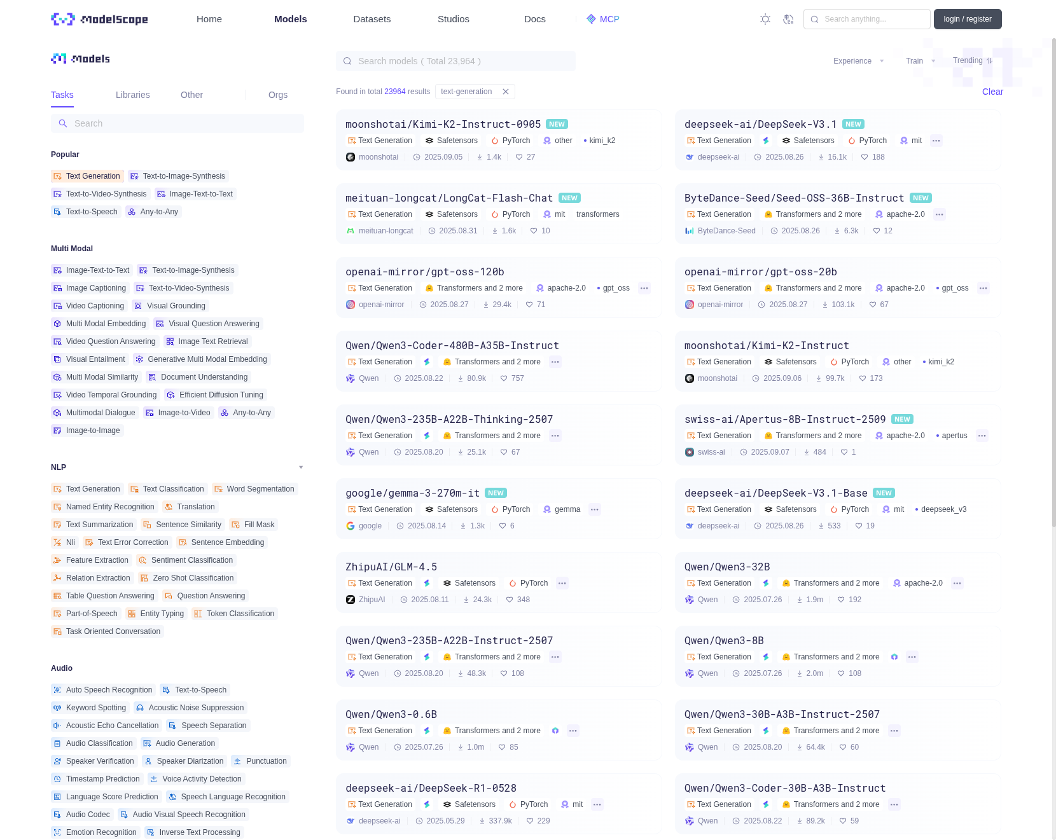
Choosing a model
https://modelscope.cn/

Slide 6
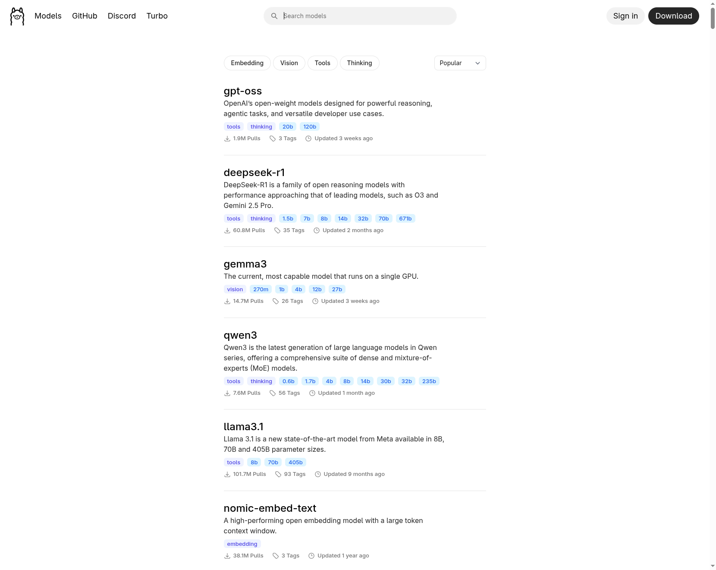
Choosing a model
https://ollama.com/

Slide 7
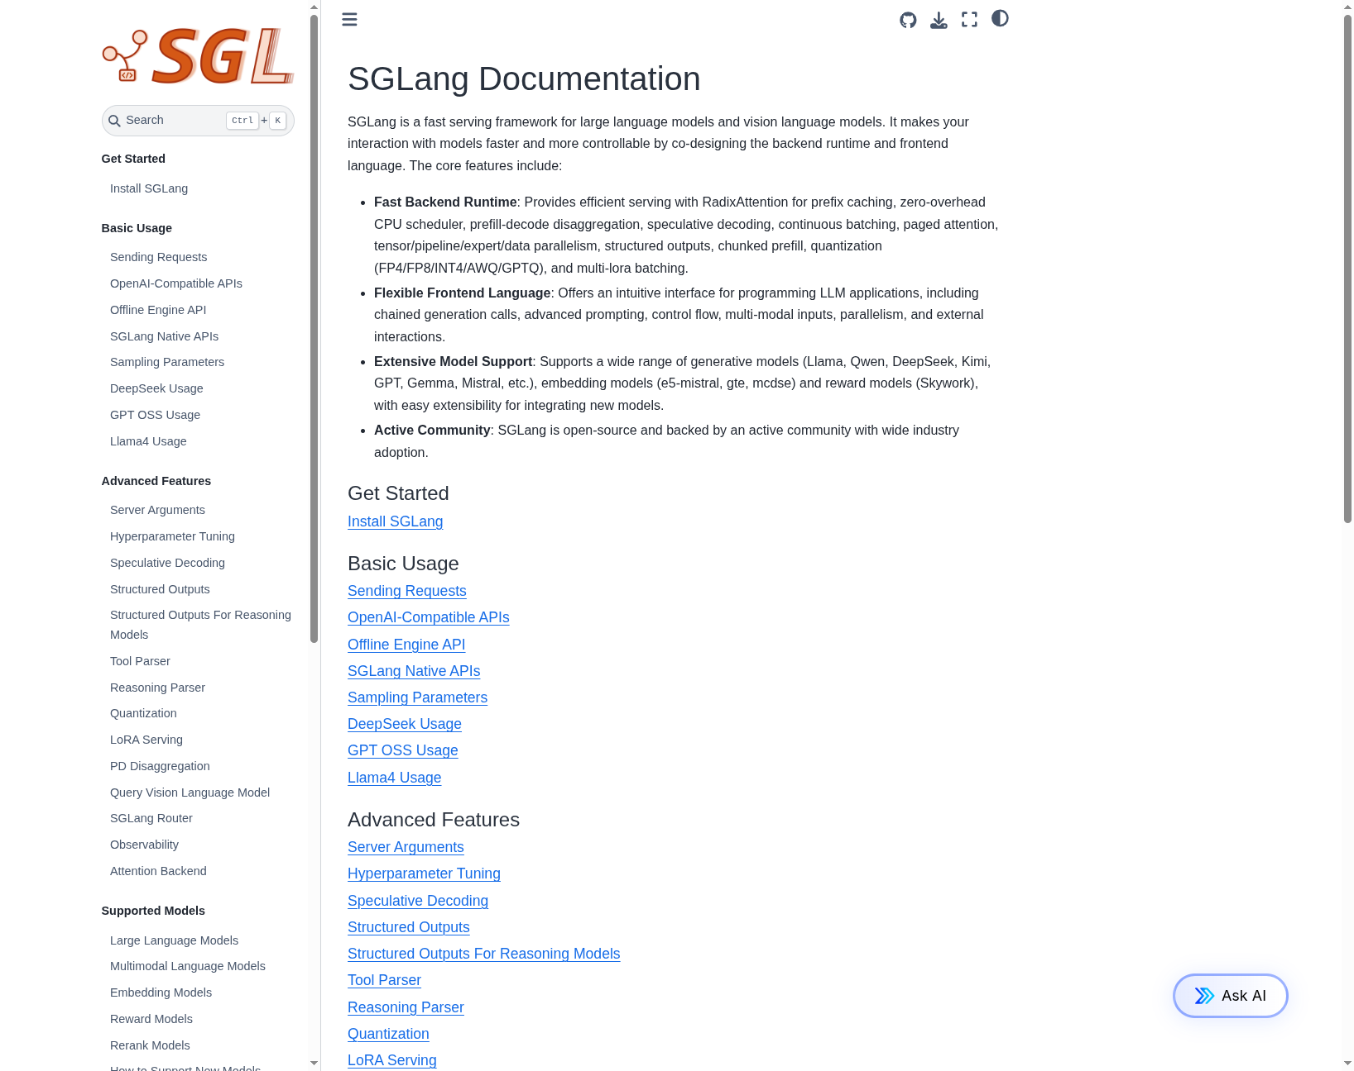
Choosing a model
https://docs.sglang.ai/

Slide 8
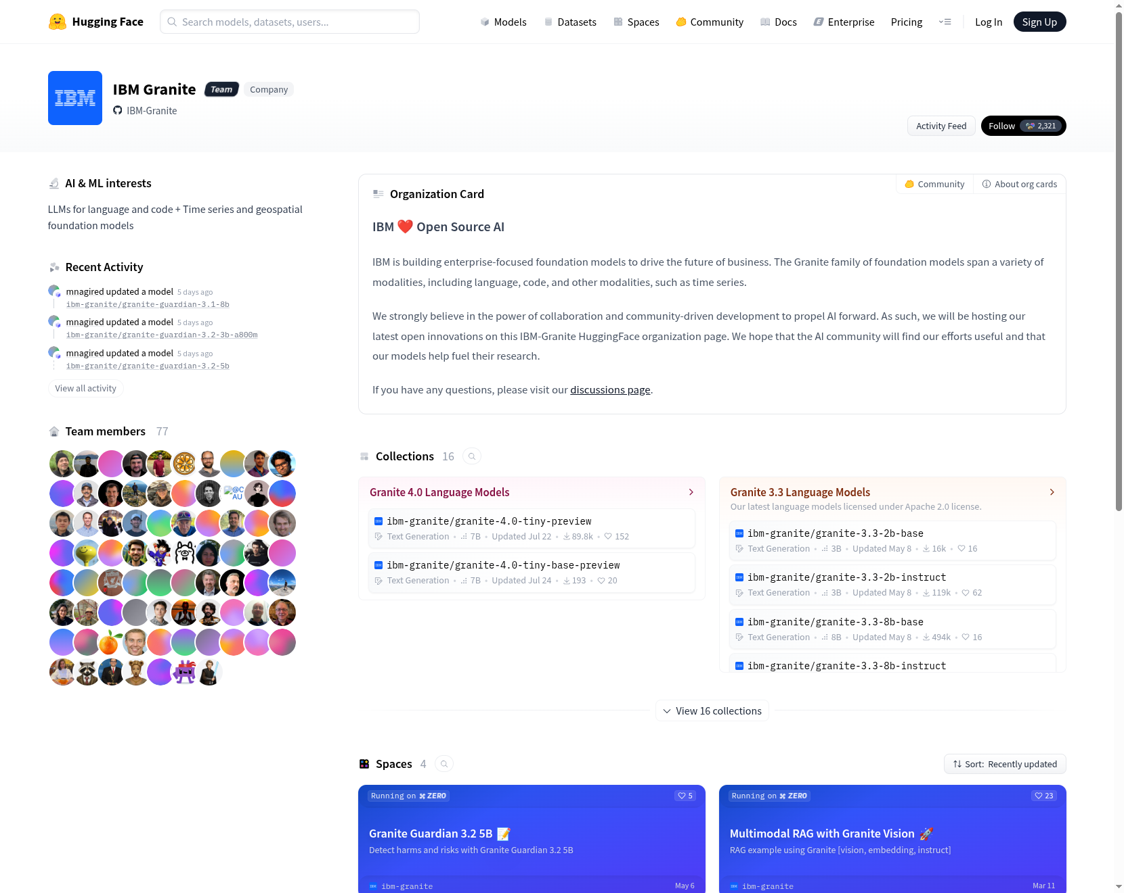
Choosing a model
https://huggingface.co/ibm-granite

Slide 9
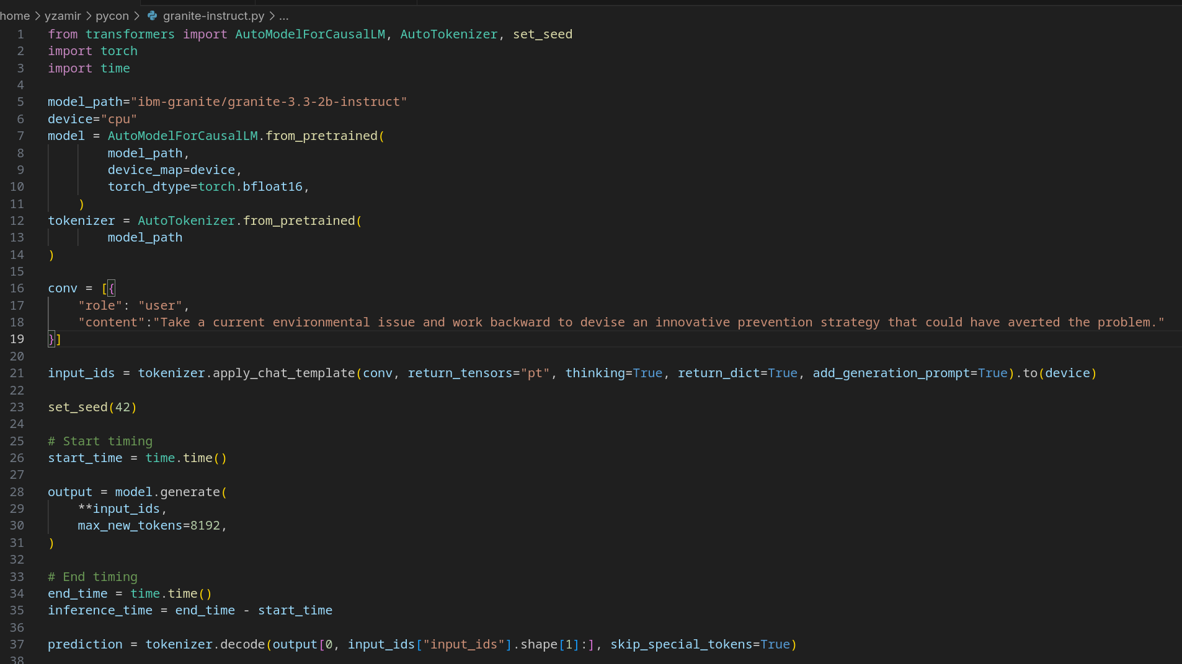
Let's write Python

Slide 10
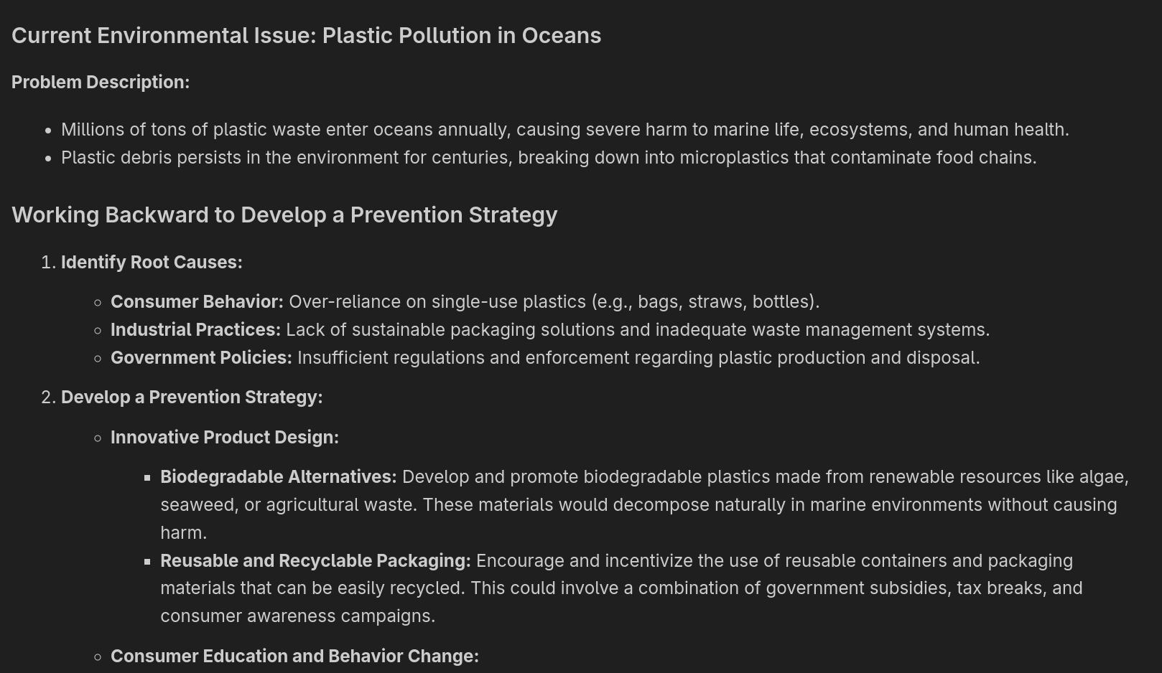
Let's write Python

Slide 11
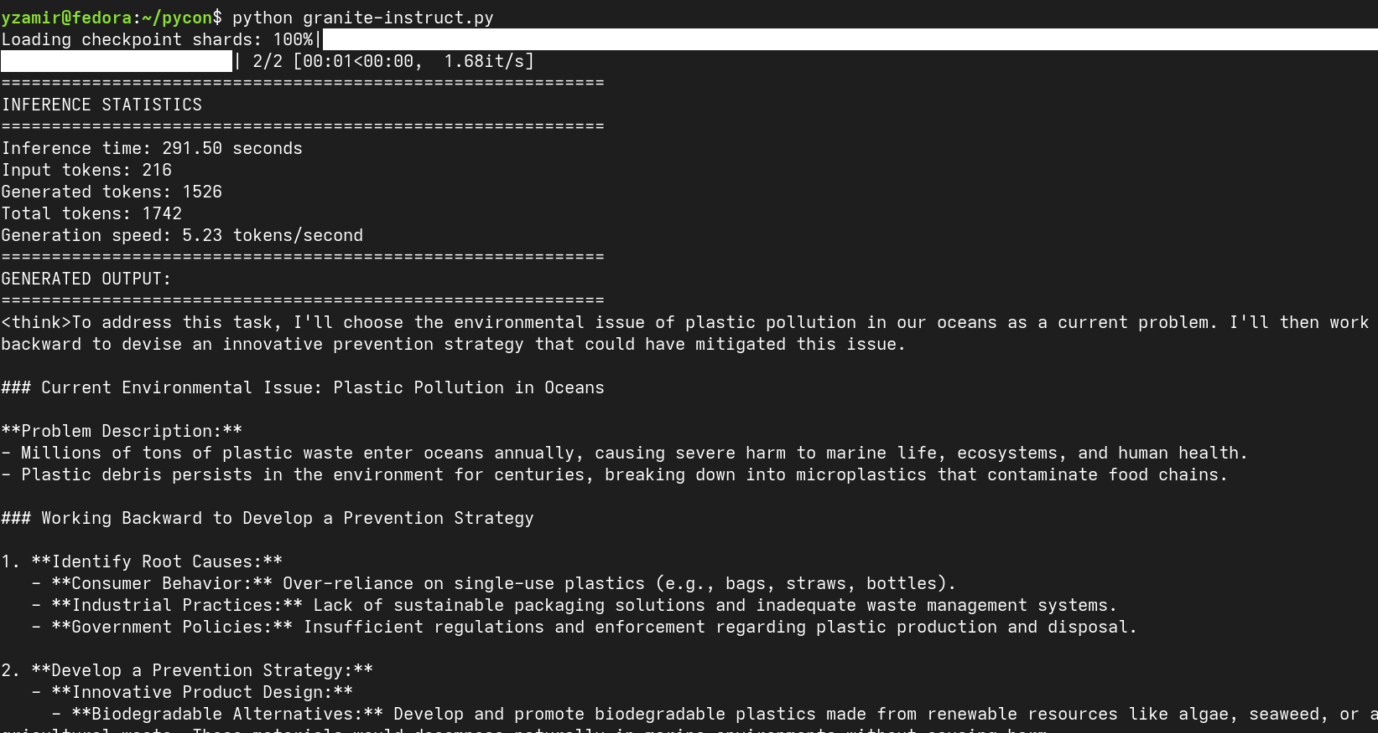
Let's write Python

Slide 12
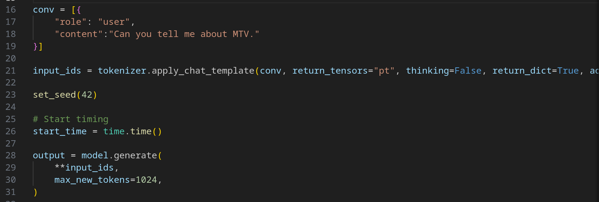
Let's write Python

Slide 13
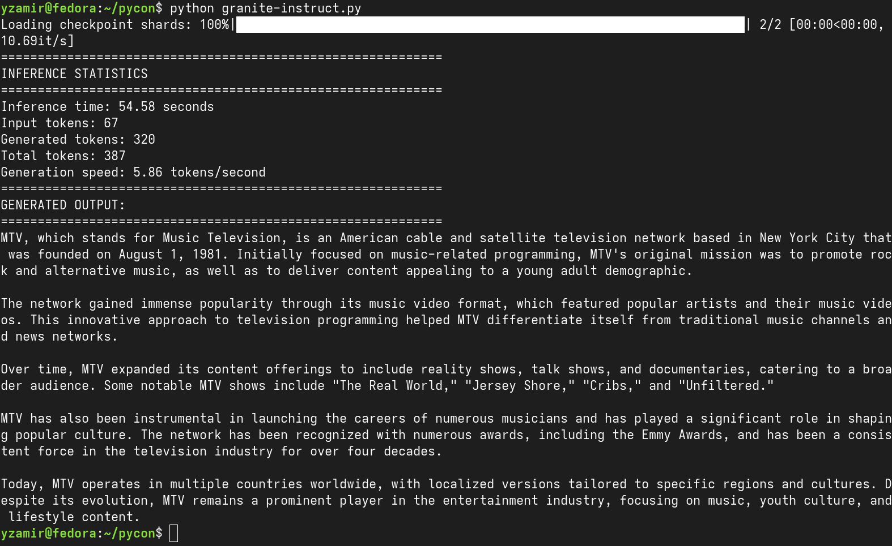
Let's write Python

Slide 14

Deliver fast responses

Slide 15
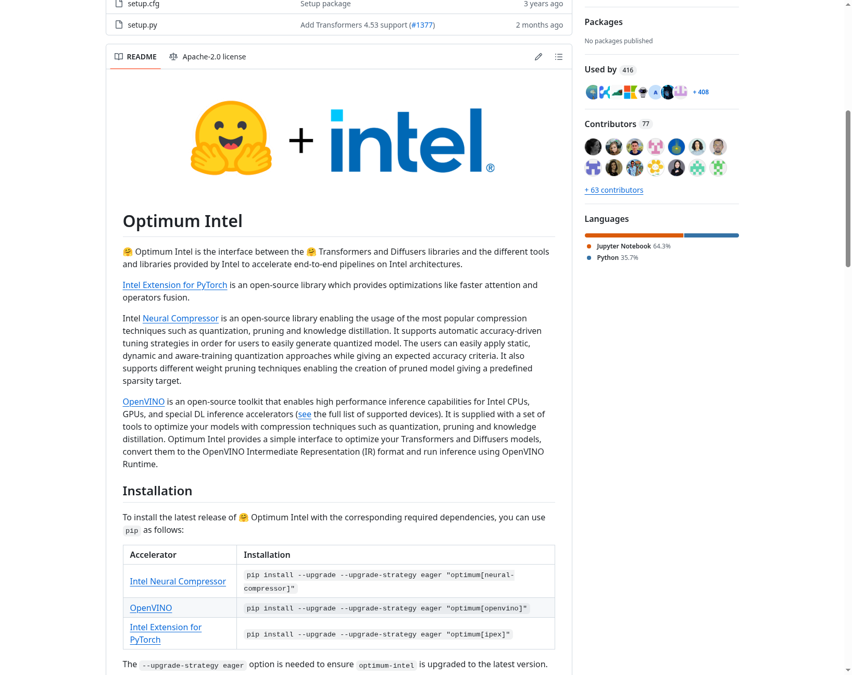
Optimization
https://github.com/huggingface/optimum-intel

Slide 16
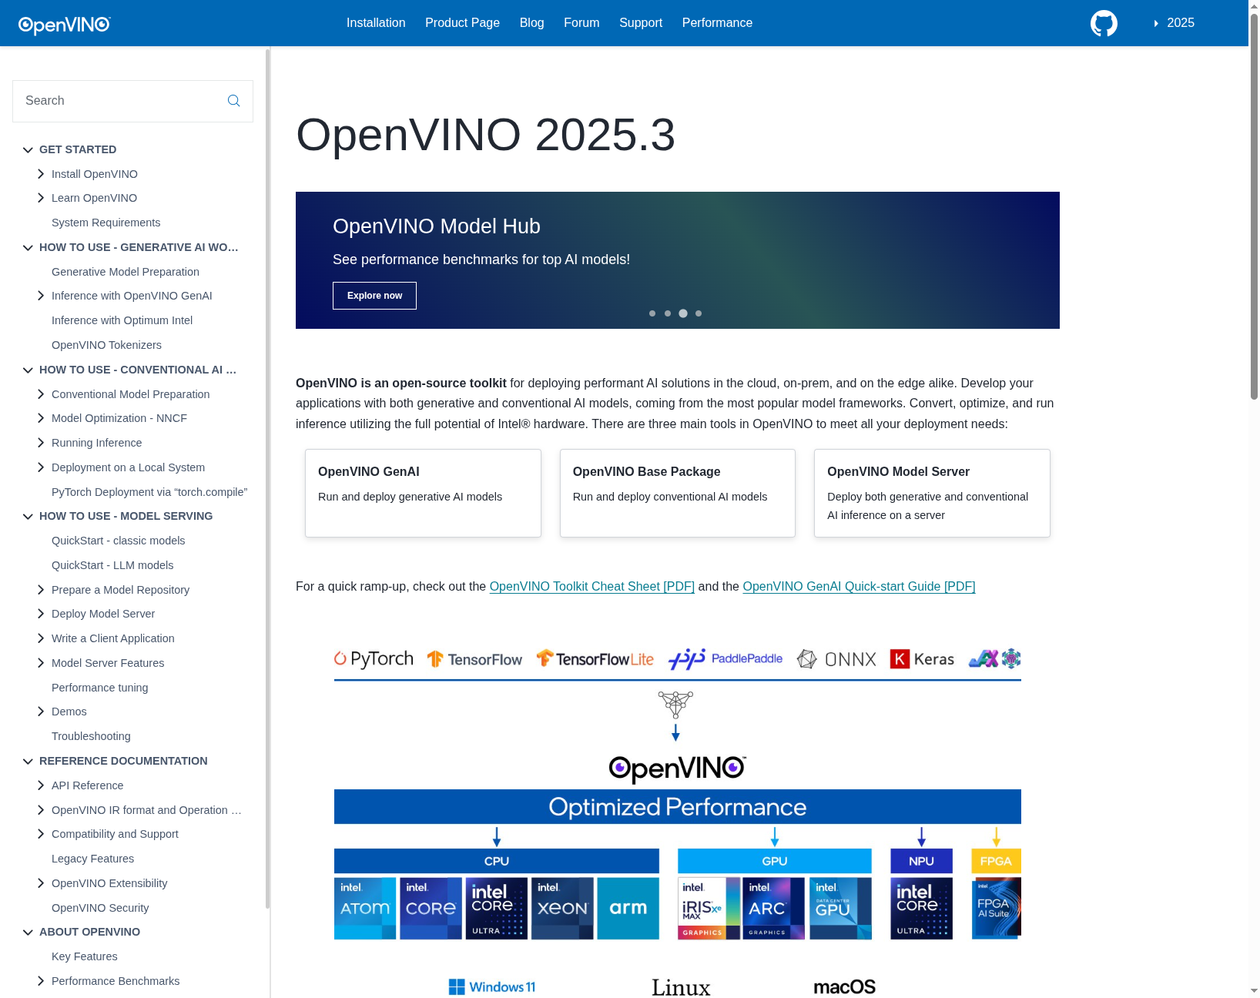
Optimization
https://docs.openvino.ai/2025/index.html

Slide 17
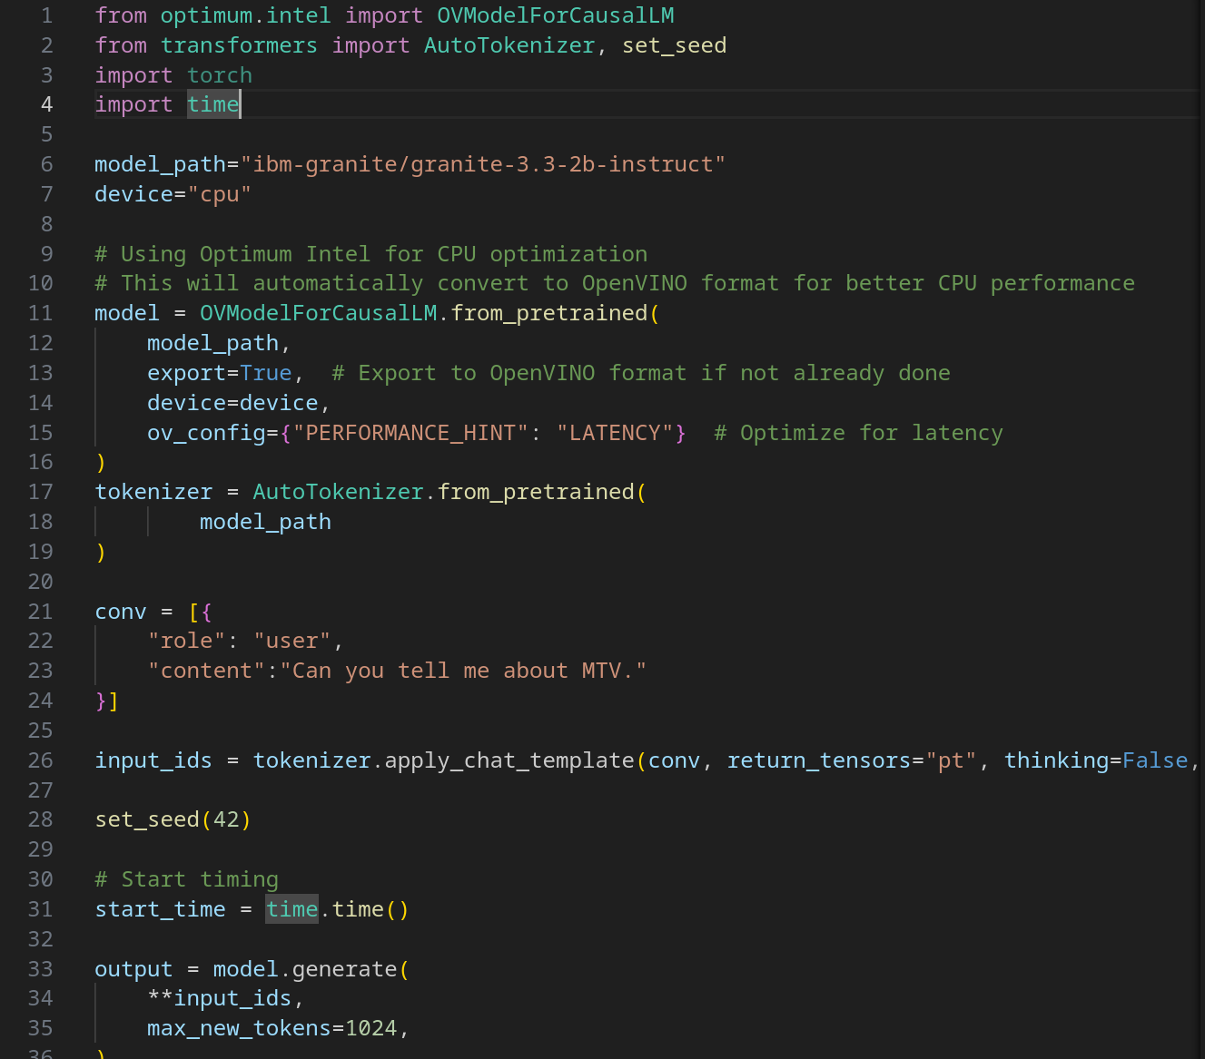
Let's write Python

Slide 18
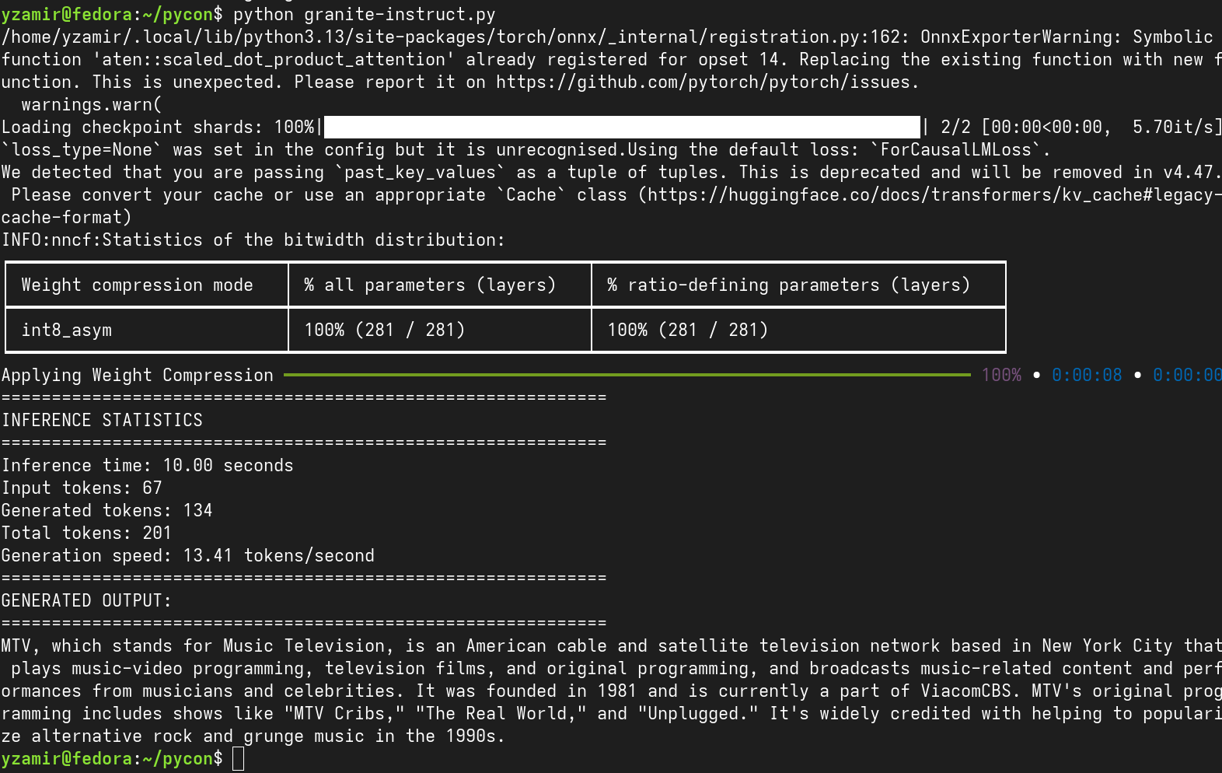
Let's write Python

Slide 19

Understand your business

Slide 20
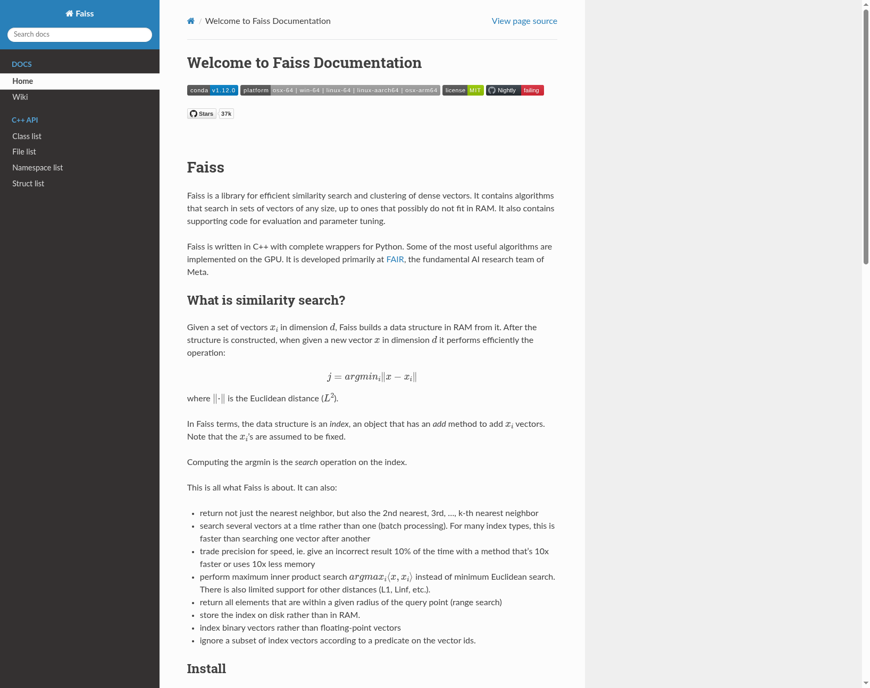
RAG
https://faiss.ai/

Slide 21
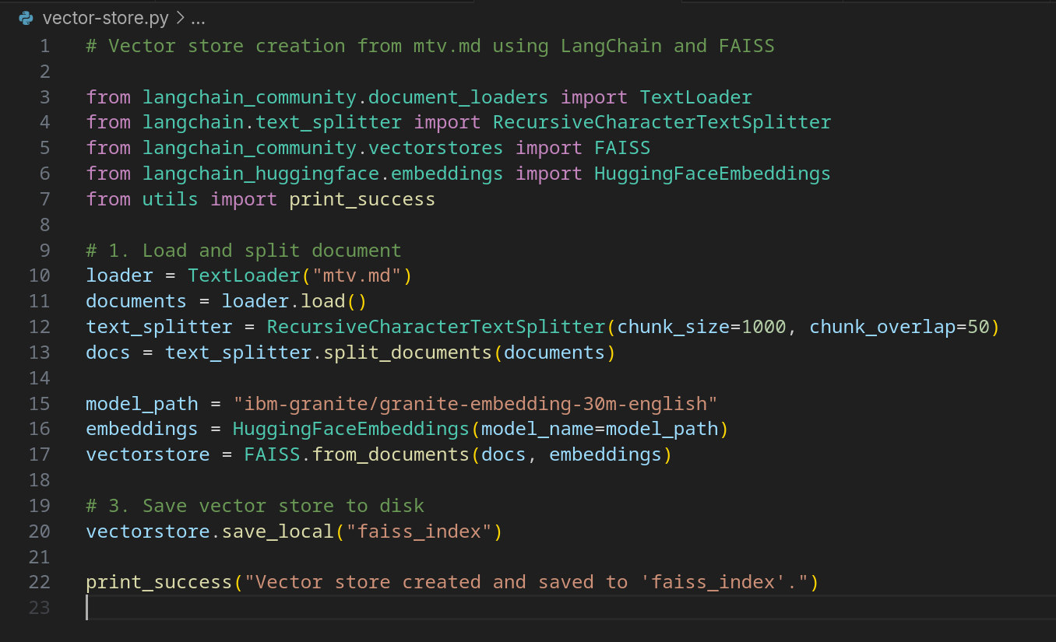
Let's write Python

Slide 22
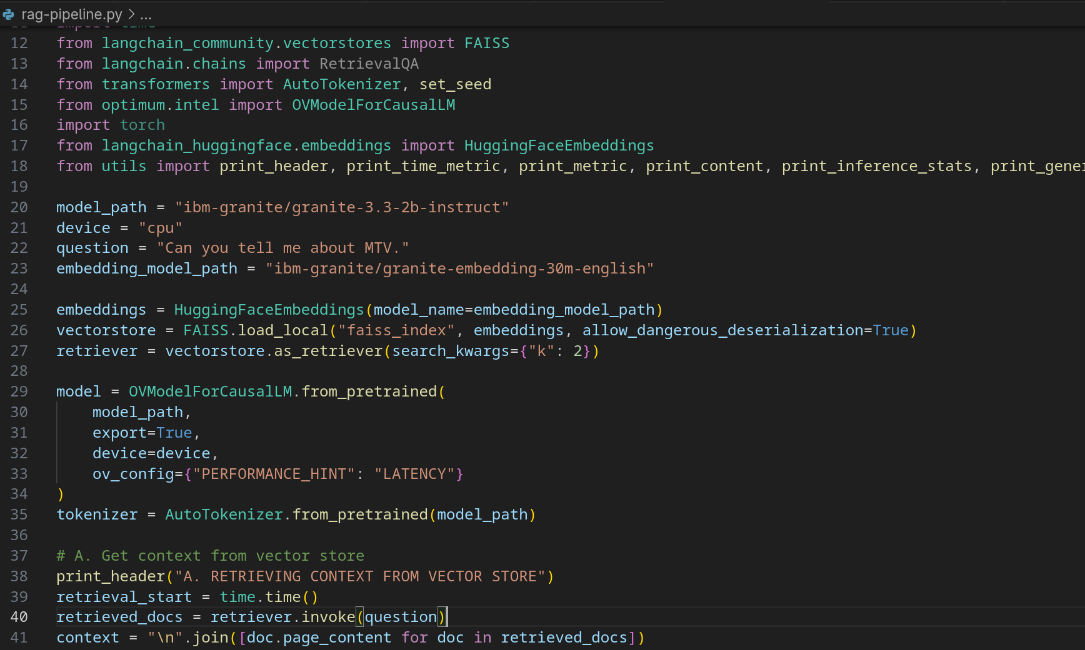
Let's write Python

Slide 23
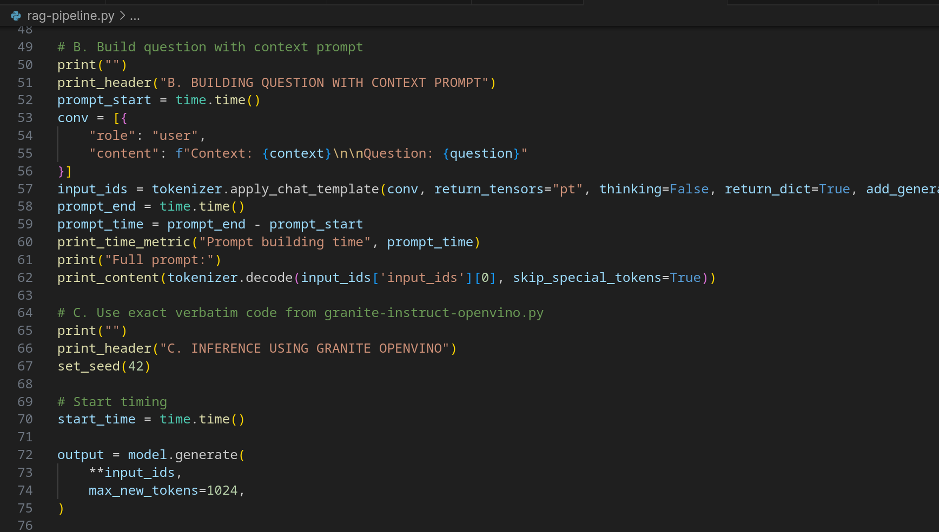
Let's write Python

Slide 24
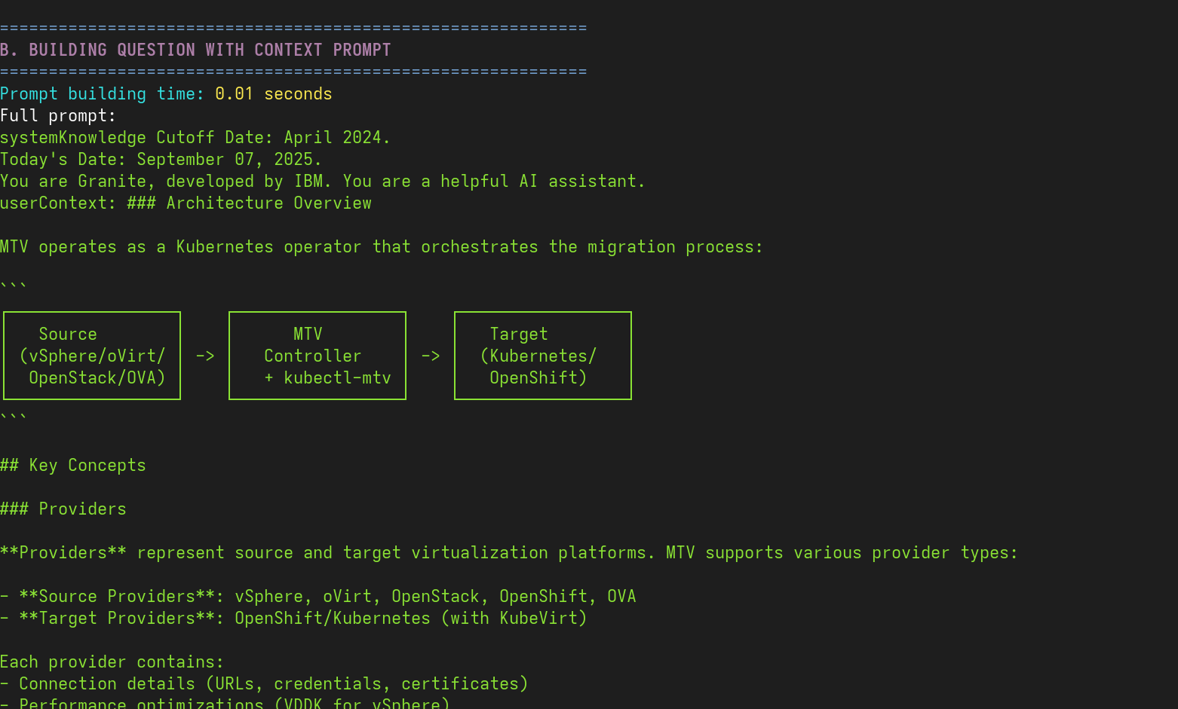
Let's write Python

Slide 25
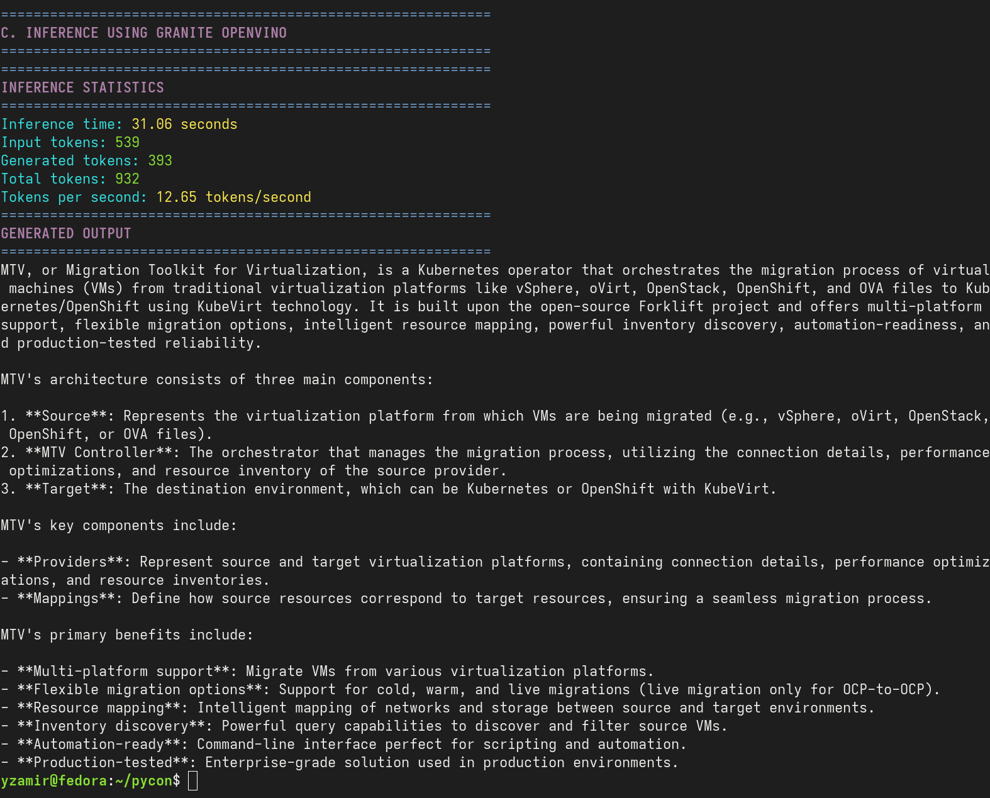
Let's write Python

Slide 26
SLM
Secure local LLM + RAG
https://pytorch.org
https://github.com/openvinotoolkit/openvino
https://www.langchain.com
https://github.com/facebookresearch/faiss
https://huggingface.co
https://www.ibm.com/granite

Slide 27
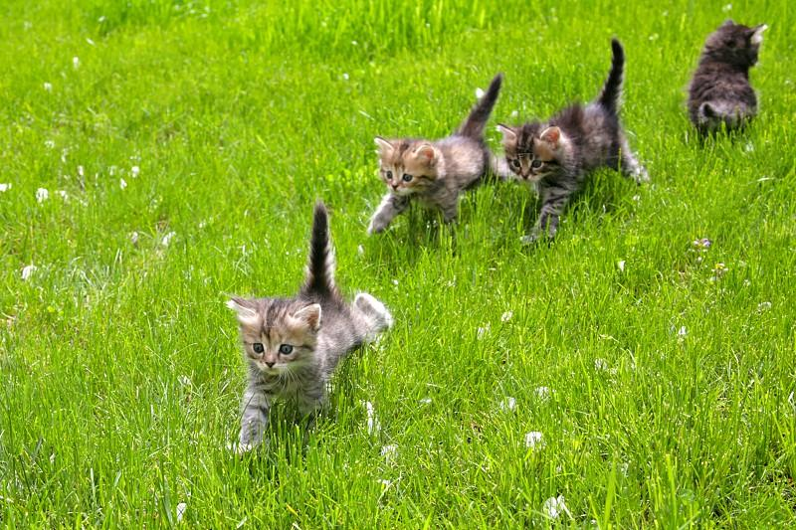
Questions ?

